Slide 1
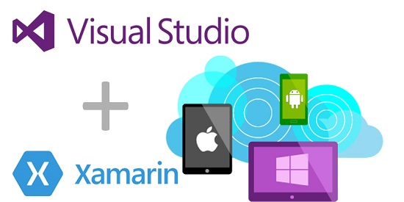
Introduction
Every organization needs their mobile apps to be available on several platforms such as Android, iOS and Windows. This might be expensive, as the application, which is expected to behave similarly on all the platforms need to be built separately, and that might require 3 distinct development teams. As the applications have the same underlying business logic and similar UI, we would like a tool which can help us build only once and use it on all those platforms. Xamarin is one such cross-platform framework which helps in building native mobile applications using the same business logic and UI.

Slide 2
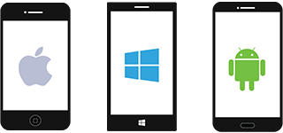
Technology
Native approach of developing mobile applications
Objective C / Swift
C#
Java
Pros: Cons:
Great applications can be built Multiple code bases
Expensive

Slide 3
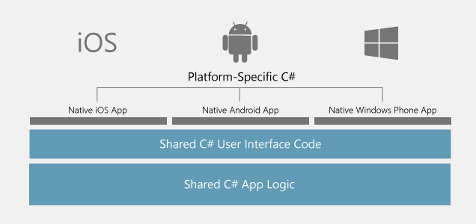
Technology
Pros
Business logic and UI will be shared
Single code base
Faster development time
Cons
Limited in capabilities
Performance improvisation needed
Xamarin approach of developing mobile applications

Slide 4
Experiment
App with Table view and a form built on Android, iOS, Xamarin
public void populateListView(){ ArrayAdapter<String> adapter = new ArrayAdapter<String>(this, R.layout.itemtextview,itemName); ListView list = (ListView) findViewById(R.id.ItemsList); list.setAdapter(adapter); }
func tableView(_ tableView: UITableView, cellForRowAt indexPath: IndexPath) -> UITableViewCell { let cell = tableView.dequeueReusableCell(withIdentifier: "cell")! cell.textLabel?.text = legends[indexPath.row] return cell; }
Android
iOS

Slide 5
public override UITableViewCell GetCell(UITableView tableView , NSIndexPath indexPath){ var cell = new UITableViewCell(UITableViewCellStyle.Default,""); cell.TextLabel.Text = names[indexPath.row]; return cell }
Xamarin

Slide 6
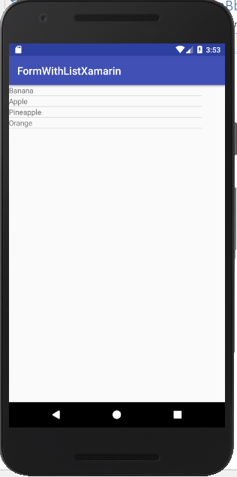
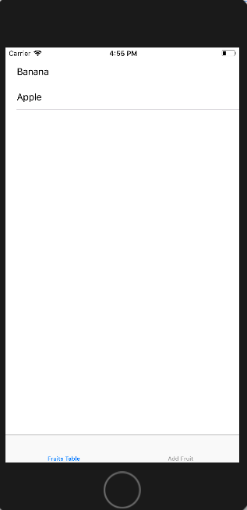
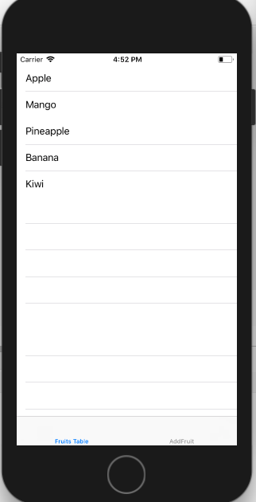
Results
Android
Build Time : 5.857s
App size : 30.6 MB
Development time : 20 mins
iOS
Build Time : 4.768s
App size : 34.4 MB
Development time : 10 mins
Xamarin
Build Time : 4.59s
App size : 41.8 MB
Development time : 20 mins

Slide 7
Conclusion
Build time of apps on Xamarin is comparatively low
Apps built on Xamarin have single code base which is shared across multiple platforms
Performance of the app is close to native
Time to market is fast due to the limited customization and extensive code sharing

Slide 8

Xamarin customers

Slide 9


Customer satisfaction
Olo
“Olo’s app platform wasn’t always built on Xamarin. Its was originally built using one of those Other Frameworks™ using JavaScript, which worked well enough for a while, but eventually put us in a tight spot.
Any engineer knows that rewriting a platform is not a task to be taken lightly, but choosing to rebuild it using Xamarin was an obvious choice.”

Slide 10



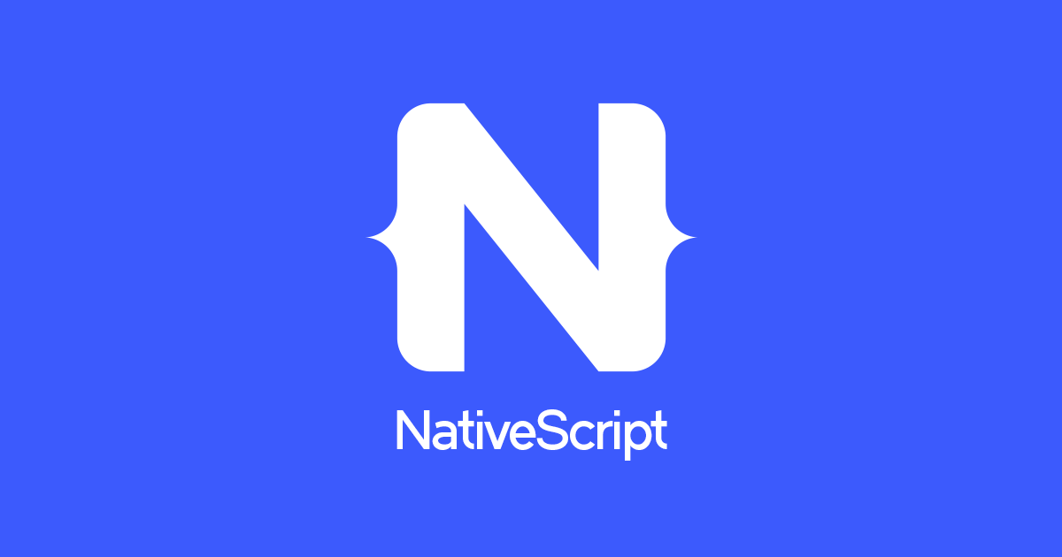
Alternatives for Xamarin
React Native
Native Script
Tabris.js
Ionic Framework

Slide 11

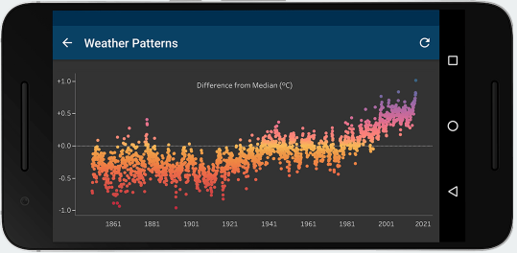
Xamarin customers
Tableau
Migrated existing Android and iOS platform-specific apps to Xamarin, resulting in a higher quality app with near-zero crash rate.

Slide 12
References
https://www.xamarin.com/
Mercado, I. T., Munaiah, N., & Meneely, A. (2016). The impact of cross-platform development approaches for mobile applications from the user's perspective. Proceedings of the International Workshop on App Market Analytics, 43-49. doi>10.1145/2993259.2993268
https://www.altexsoft.com/whitepapers/pros-cons-of-native-vs-cross-platform-mobile-development-xamarin/
https://www.altexsoft.com/blog/mobile/5-step-guide-to-choosing-between-native-and-cross-platform-development/

